Slide 1
Mystic River
Name
Institutional Affiliation

Slide 2
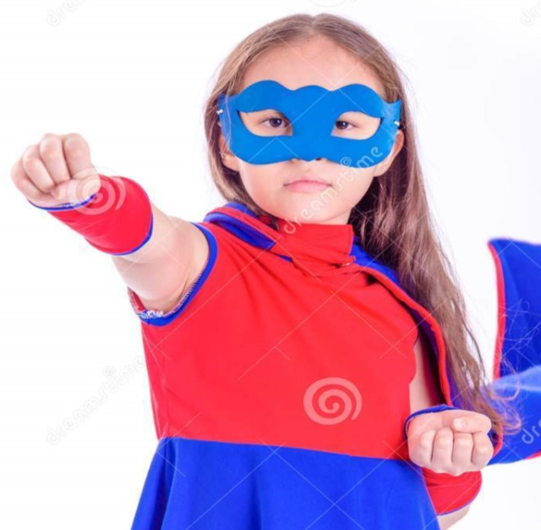
Introduction
Skalar was a young pretty girl who lived in a small village with her parents.
Ever since she was born, the family had been faced with numerous tragedies including the death of two sons (Arnaudo n.p)
Her family had used all the resources and were on the verge of being ridden with poverty.
Notes:
Skalar was a young little girl who right from her childhood showcased signs of stardom. She was born to a poor family where the parents could not afford the basic essentials. The family could not afford the basic necessities as they were getting old. The state of their family kept Skalar thinking.

Slide 3
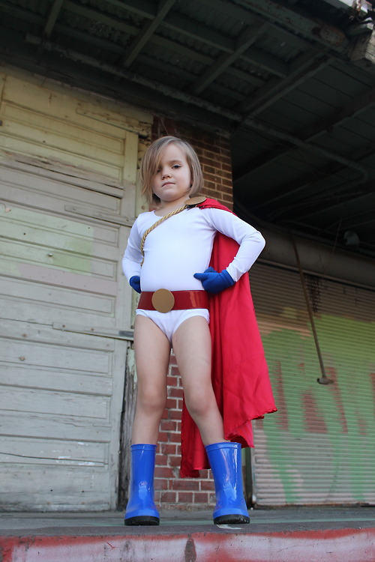
Superhero
Their only hope was on their daughter, who despite young was bright and way ahead of her peers.
Skalar was quite critical of her family but as a young girl, she swore to change their fortunes someday (Gilmore n.p).
Skalar attended a local school in her village.
Her teachers lauded her exemplary talent in singing.
She was a member of the school drama club.
Notes:
The parents only hope was on Skalar who despite her young age, had dreams of changing the fortunes of her family. Skalar was a member of the drama club which allowed scalar to utilize and develop her talent. Despite being a good singer, Skalar could act in the drama club something that made her famous at an early age.

Slide 4
Superhero Cont.
Despite being a great singer, Skalar was blessed with the ability to influence the future.
She became aware of this ability when she was on the vrge of being eliminated from the school drama club (Arnaudo n.p)
In one of the auditions, Skalar wished that her remaining opponent could be eliminated from the auditions.
Her wish was granted when she was selected to represent the school.
Skalar defied the odds of making the cut despite having no odds.
Notes:
Skalar had a thing of influencing a situation for her benefit. In most occasions, she was faced with situations where she depended on luck to succeed. At some point, she was at the helm of being eliminated but sought intervention through her abilities to be able to succeed. Despite defying the odds to succeeded, Skalar felt that she had some sought of control that helped her influence the future.

Slide 5
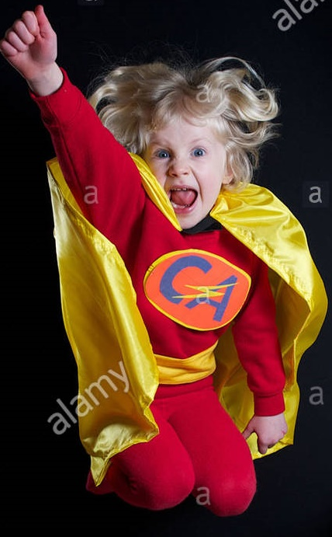
Superhero Cont.
What started as a wish soon made Skalar a small superhero.
It was a wish at the finals that their school emerged victorious.
The victory at the finals is what informed Skalar that she had an ability.
The turning point of this superhero was at the point when her family was to be evicted.
Notes:
Skaler influenced a lot of things including her school’s success in the drama competition. As these things happened in her favor, she developed a deep conviction of having some sort of powers in which she could use to influence things to go her way. The turning point of it is when she succeeded in helping the fmily from being evicted.

Slide 6

Superhero Cont.
Skalar new that she was the only hope for her parents.
Despite being young, she knew that she had a role to play.
Their neighbors could not sympathize as they laughed off their predicament.
The opportunity provided a platform for Skalar to make a wish that could change the fortunes of the family (Arnaudo n.p)
In her wish, Skalar hope that her family would not be evicted.
Notes:
The incidence when she turned the fortunes in favor of the parents showed that she had a role in helping a parents avoid an embarrassing eviction incidence. Despite her stellar performance and growth in the drama club, her neighbors could not stop being envious. During periods when she was pressed, Skaler could go to a secret place in some sought of meditation to seek divine intervention.

Slide 7
Superhero Cont.
Her wish was granted when her father received a call from the pensioner.
The call informed him that he had been paid for his service with the municipal council (Gilmore n.p).
It is the payment that allowed the family to offset their debts.
They were not kicked out but their problems could not end.
At school, Skaler became an envy of other students something that brought her many enemies.
Notes:
The family managed to settle their bills after the father received his pension from the municipal council. Skaler had wished that something could happen that could help the family avoid eviction. When her wish was granted, Skaler felt that she could actually change things including the desire to change the fortunes of her family.

Slide 8

Superhero Cont.
The enmity could soon be brought to test when she was to battle out for a position at the nationals singing competition.
Skalar was battling with a rich girl who could easily be favored.
The day of competition, she emerged victorious after a unanimous decision.
The selection made her famous but was faced with more challenges.
Notes:
The other test of the superhero nature of Skaler occurred when she helped her school win the national singing competition. Before the final, Skaler hoped that she could put on a performance that could make her the winner. On the material day, her performance was exemplary as a result of great voice that wowed the entire crowd. Despite the victory, many people felt jealous for her success.

Slide 9

Superhero Cont.
At the nationals, the competition was tight as whole the contestants performed beyond expectation.
When Skaler’s time came, her performance was astonishing!
Her voice was captivating and her presentation wowed the entire crowd (Gilmore n.p).
She quickly became a fan’s favorite since her voice was quite different.
It became evident that the good tidings followed her.
Notes:
The astonishing performance on the day of the competition should be credited for her abilities. It is her ability to influence events that Skaler was able to emerge victorious. The victory made her famous something that attracted more fans for her. It was this unique victory that Skaler was considerd a superhero as she did extraordinary things at her young age.

Slide 10
Superhero Cont.
Skaler did an exemplary presentation that touched all the audience,
The prowess in her voice and the message of the presentation puzzled even the teachers.
Skaler was becoming a superhero who trounced her opponents despite being an unknown figure.
Her fame grew as she helped her community and village to receive a grant that could upgrade the village.
The life of her parents could soon change.
Notes:
The voice of the presentation was heavenly. She showed prowess at the highest stage writing history and defying the odds. Despite coming from a poor background, Skaler had broken barriers that made her family known and eased the pressure for her parents in meeting their daily needs. What followed was a life full of success that changed her family’s fortunes.

Slide 11
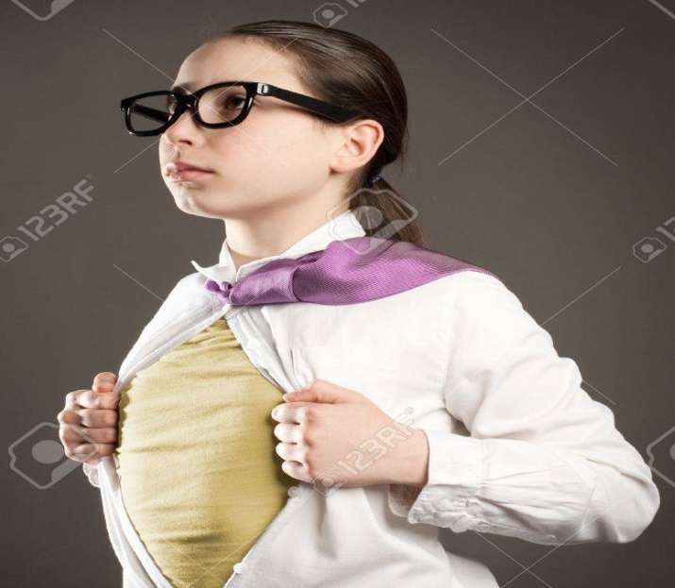
Superhero Cont.
Skaler was a superhero who used her abilities to change the fortunes of her family and community.
Despite receiving enormous opposition, her humility granted her the best wishes (Gilmore n.p).
Despite being loved and hated in equal measure, she could not stop winning.
Notes:
Skaler was a superhero who used her talent and abilities to fight her enemies and gain fame. It is through fame and her talent that she managed to change the destiny of her family. Even though she was hated and loved in equal measure, Skaler kept on winning something that made her a little superhero.

Slide 12
Works Cited
Arnaudo, Marco. The Myth of the Superhero. JHU Press, 2013.
Gilmore, James N., and Matthias Stork, eds. Superhero Synergies: Comic Book Characters Go Digital. Rowman & Littlefield, 2014.

